Slide 1
Music Player Project
Developed by Vishwas Verma during an internship with Unified Mentor HTML, CSS, and JavaScript

Slide 2
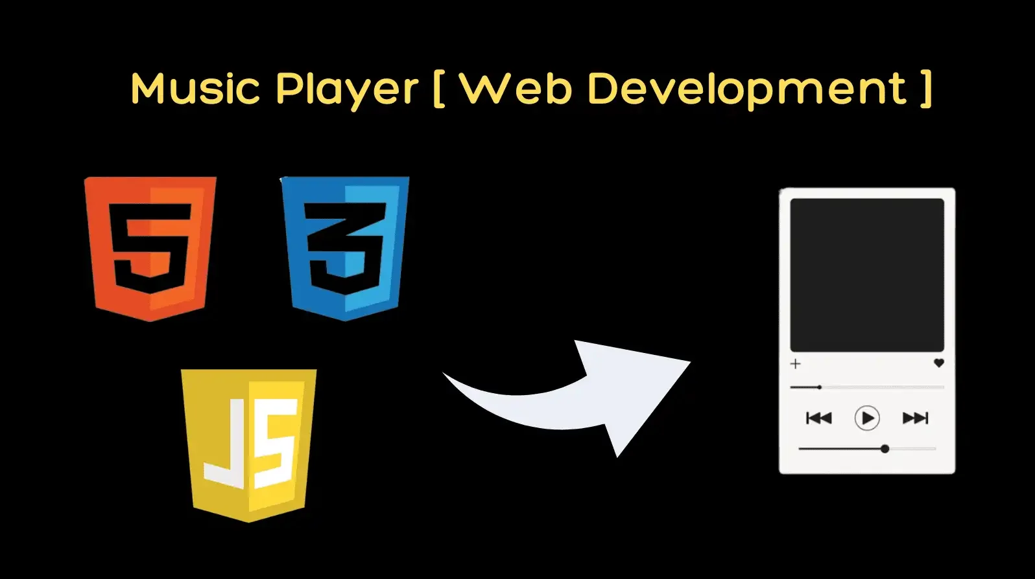
Introduction
This project is a web-based music player application developed using HTML, CSS, and JavaScript. It provides hands-on experience in building a user-friendly and interactive music player.

Slide 3
Features
User Interface: Clean and intuitive design with controls for play, pause, volume adjustment, and progress bar.
Audio Playback: Ability to play audio files using HTML5's audio element.
Playlist Management: Allows users to create, add, and remove songs from a playlist.
Responsive Design: Works well on different screen sizes and devices.

Slide 4
Code Implementation
JavaScript Code Snippet for Play/Pause Functionality:
function playpauseTrack(){ if (isPlaying) { isPlaying = false; pauseTrack(); } else { isPlaying = true; playTrack(); } } and other functions …

Slide 5
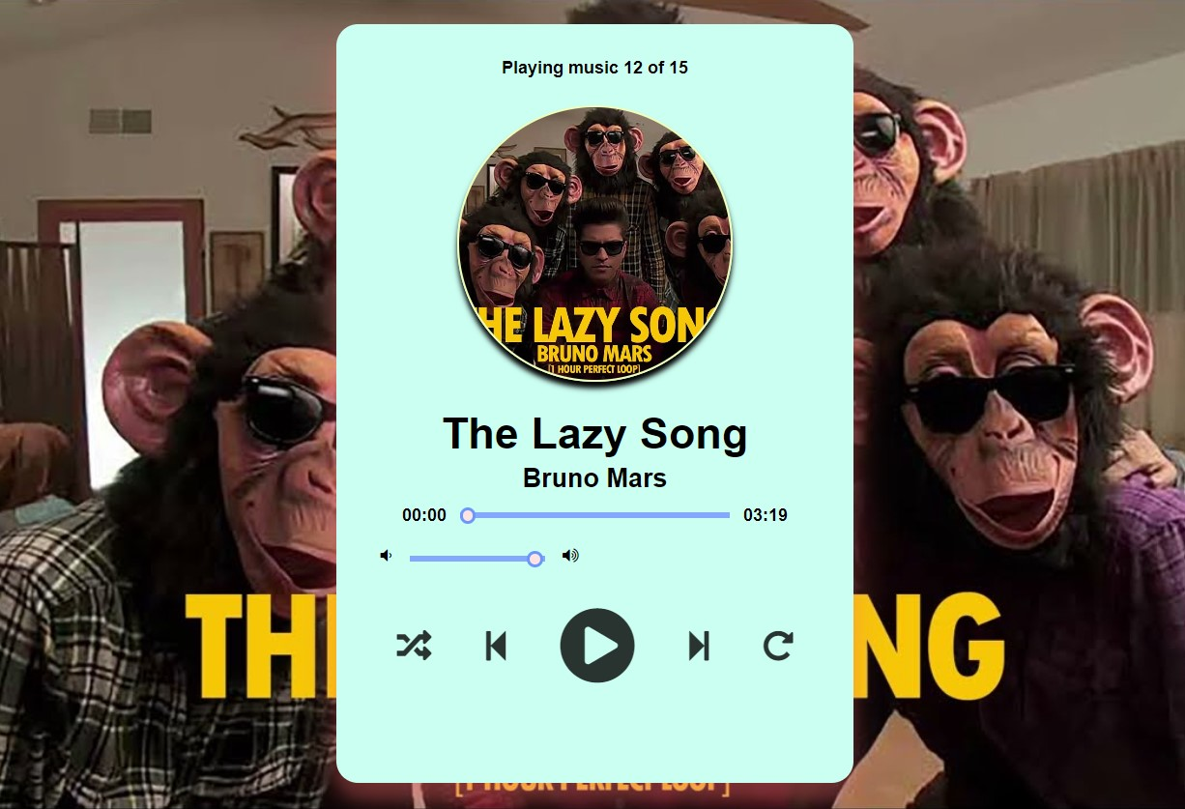
Challenges & Solutions
Ensuring smooth audio playback and transition between tracks.
Implementing responsive design that works across various devices.
Handling local storage to retain user settings and track information.

Slide 6
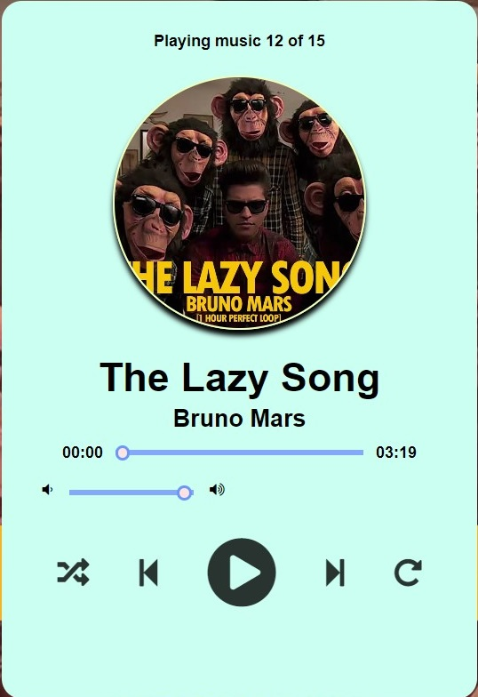
Conclusion
The music player project demonstrates the effective use of HTML, CSS, and JavaScript to create a functional, user-friendly web application. Additional features can be incorporated to enhance the user experience.

